Slide 1

School of Computing Science and Engineering
Course Code: BCS0IT1003 Course Name: Programming for Problem Solving-C
Unit – 2
Control Statements (Iteration statements and Jump statements)
Program Name: B.Tech

Slide 2
Programming for Problem Solving-C
Recap:-
Control statements:
Decisions(if-else) ✓
Loops (for, while, do-while)
break, continue
case control structure
go to
exit statement

Slide 3
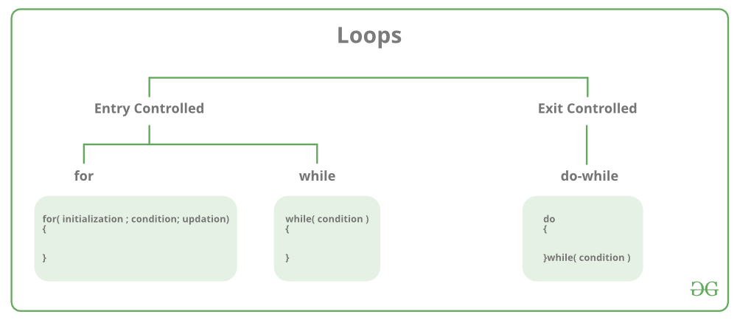
Iteration statement
Iteration statements (also called loops) allow a set of instructions to be repeatedly executed until a certain condition is reached.
This condition may be
Entry controlled (for loop, while loop) or
Exit controlled (do-while loop)

Slide 4
Iteration statement – for loop
for Loop
It allows a block of code to be executed repeatedly for specified iteration.
Syntax of the for loop statement is :
for (initialization; condition; increment)
{
statement 1;
statement 2;
---
statement n;
}

Slide 5
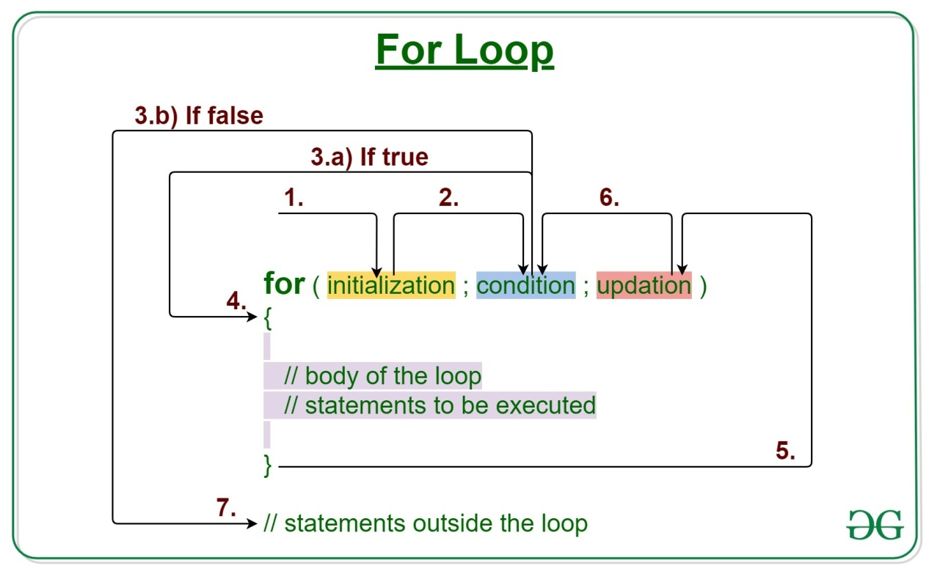
Iteration statement – for loop
The initialization is an assignment statement that is used to set the loop control variable.
The condition is a relational expression that determines when the loop exits.
The increment defines how the loop control variable changes each time the loop is repeated.
The for loop continues to execute as long as the condition is true.
Once the condition becomes false, program execution resumes on the statement following the for.

Slide 6
Iteration statement – for loop
#include <stdio.h>
int main(void)
{
int x;
for(x=1; x <= 100; x++)
printf("%d ", x);
return 0;
}
In the loop, x is initially set to 1 and then compared with 100. Since x is less than 100, printf( ) is called and the loop iterates. This causes x to be increased by 1 and again tested to see if it is still less than or equal to 100. If it is, printf( ) is called. This process repeats until x is greater than 100, at which point the loop terminates.

Slide 7
Iteration statement – for loop
Example program for “for”
Write a C program to find the sum and average of ‘n’ positive numbers ?
#include <stdio.h>
int main()
{
int num, i, sum = 0;
printf("Enter a positive integer number: ");
scanf("%d", &num);
for(i = 1; i <= num; i++)
{
sum += i; // sum=sum+i
}
printf("Sum = %d", sum);
printf("Average = %d", sum/num);
return 0;
}
Output
Enter a positive integer number: 5
Sum = 15
Average = 3

Slide 8
Iteration statement – while loop
while Loop
It allows code to be executed repeatedly based on a given Boolean condition. The while loop can be thought of as a repeating if statement.
Syntax of the while statement is :
while(condition)
{
statement 1;
statement 2;
---
statement n;
updation;
}

Slide 9
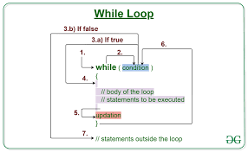
Iteration statement – while loop
The condition is a relational expression that determines when the loop exits.
The increment should defines within the statement to make the loop repeat certain time.
Once the condition becomes false, program execution resumes on the statement
following the while.

Slide 10
Iteration statement – while loop
// C program to illustrate while loop
#include <stdio.h>
int main()
{
// initialization expression
int i = 1;
// test expression
while (i < 6)
{
printf("Hello World\n");
i++; // update expression
}
return 0;
}
Output
Hello World
Hello World
Hello World
Hello World
Hello World

Slide 11
Iteration statement – do while loop
do while Loop
It executes a block of code at least once, and then either repeatedly executes the block, or stops executing it, depending on a given boolean condition at the end of the block.
Syntax of the do-while statement is :
do
{
statement 1;
statement 2;
---
statement n;
} while(condition);

Slide 12
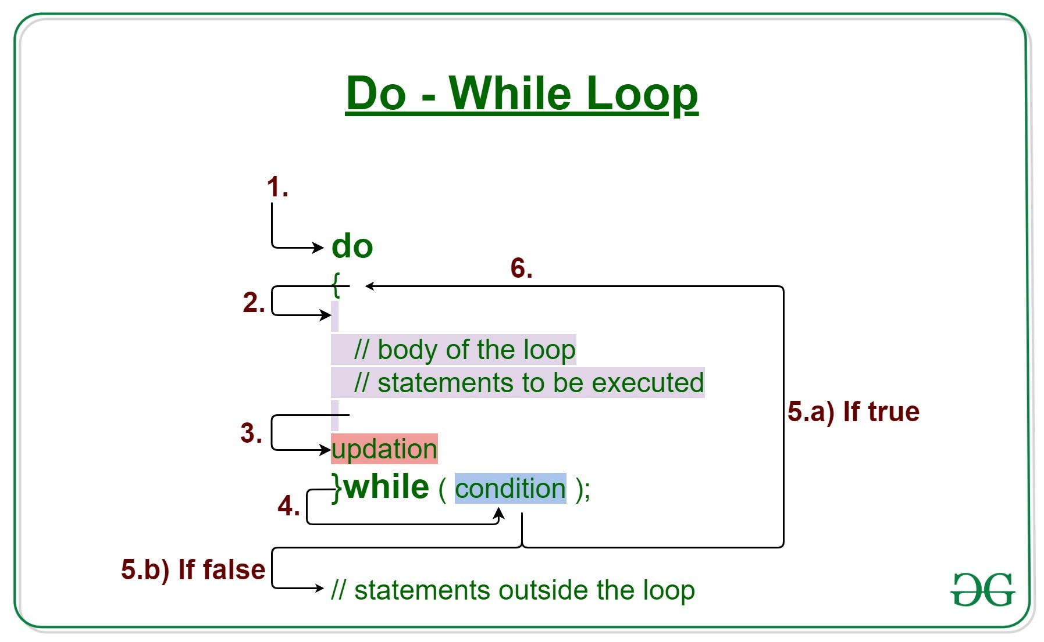
Iteration statement – do while loop
This loop will execute at least once.
The condition is a relational expression that determines when
the loop exits.
The increment should defines within the statement to make the loop repeat certain
time.
Once the condition becomes false, program execution resumes on the statement
following the do while.

Slide 13
Iteration statement – do while loop
// C program to illustrate do-while loop
#include <stdio.h>
int main()
{
// Initialization expression
int i = 7;
do
{
// loop body
printf("Hello World\n");
// Update expression
i++;
} while (i < 6); // Test expression
return 0;
}
Output
Hello World

Slide 14
Jump Statements
C has four statements that perform an unconditional branch:
return, goto, break, and continue.
return and goto can be use anywhere inside a function.
break and continue statements can be use in conjunction with any of the loop statements.
break can be use with switch.

Slide 15
Jump Statements - return
The return statement
The return statement is used to return from a function.
It is categorized as a jump statement because it causes execution to return (jump back) to the point at which the call to the function was made.
A return may or may not have a value associated with it.
Syntax :
return expression;

Slide 16
Jump Statements - return
The return statement with no value
#include <stdio.h>
void sqr(int x); // function prototype declaration
int main(void)
{
int t=10;
printf("%d", t);
sqr(t); // function call, ‘t’ is actual parameter
return 0;
}
void sqr(int x) // function definition, ‘x’ is formal parameter
{
x = x*x;
printf(“\t%d", x);
return;
}
Output
10 100

Slide 17
Jump Statements - return
The return statement with value
#include <stdio.h>
int sqr(int x); // function prototype declaration
int main(void)
{
int t=10;
printf("%d %d", t, sqr(t));
return 0;
}
int sqr(int x) // user defined function sqr()
{
x = x*x;
return(x);
}
Output
10 100

Slide 18
Jump Statements - return
The return statement
We can use as many return statements as you like within a function. However, the function will stop executing as soon as it encounters the first return.
The } that ends a function also causes the function to return. It is the same as a return without any specified value.

Slide 19
Jump Statements - break
The break statement
It can use to terminate a case in the switch statement. (covered in the section on switch earlier in this chapter).
It can also use it to force immediate termination of a loop, bypassing the normal loop conditional test.
When the break statement is encountered inside a loop, the loop is immediately terminated, and program control resumes at the next statement following the loop

Slide 20
Jump Statements - break
Example Code
#include <stdio.h>
int main(void)
{
int t;
for(t=0; t < 100; t++)
{
printf(“%d”, t);
if(t == 10)
break;
}
return 0;
}
Output
0 1 2 3 4 5 6 7 8 9 10
prints the numbers 0 through 10 on the screen. Then the loop terminates because break causes immediate exit from the for loop, overriding the conditional test t<100.

Slide 21
Jump Statements - break
A break causes an exit from only the innermost loop.
Example Code
Output
1 2 3 4 5 6 7 8 9
1 2 3 4 5 6 7 8 9
1 2 3 4 5 6 7 8 9
1 2 3 4 5 6 7 8 9
1 2 3 4 5 6 7 8 9
#include <stdio.h>
int main(void)
{
int i, count;
for(i=1; i<=5; i++)
{
count = 1;
for(;;)
{
printf("%d ", count);
count++;
if(count == 10)
break;
}
printf("\n");
}
}
Each time ‘count’ equal to 10, the compiler encounters break, it breaks its loop or block and control is passed back to the outer for loop.

Slide 22
Jump Statements - continue
The continue statement
The continue statement works somewhat like the break statement.
Instead of forcing termination (break), however, continue forces the next iteration of the loop to take place, skipping any code in between.
In the for loop, continue causes the increment and then the conditional test portions of the loop to execute.
In the while and do-while loops, program control passes to the conditional tests

Slide 23
Jump Statements - continue
Example Code
#include <stdio.h>
int main(void)
{
int t, count;
for(t=1; t<=20; t++)
{
if(t%2==0)
continue;
else
printf("%d\n", t);
}
}
Output
1
3
5
7
9
11
13
15
17
19
prints the odd numbers between from 1 to 20 on the screen. Each time the compiler encounters continue it bypass its loop or block and control is passed back to the outer loop.

Slide 24
Jump Statements – break vs continue
break continue
for(int t=1; t<=100; t++) {
if(t%2==0)
break;
else
printf("%d\n", t);
}
for(int t=1; t<=100; t++) {
if(t%2==0)
continue;
else
printf("%d\n", t);
}
prints 1 on the screen.
prints the odd numbers between from 1 to 100 on the screen.

Slide 25
Thank You

